Slide 1
Storytelling Case Study : Airbnb, NYC Head of Acquisitions & Operations, NYC Head of User Experience, NYC
Name : Swapnil Johri

Slide 2
Background
For the past few months, Airbnb has seen a major decline in revenue. Now that the restrictions have started lifting and people have started to travel more, Airbnb wants to make sure that it is fully prepared for this change.
The different leaders at Airbnb want to understand some important insights based on various attributes in the dataset so as to increase the revenue, such as –
Which type of hosts to acquire more and where?
What are the neighborhoods they need to target?
What is the pricing ranges preferred by customers?
The various kinds of properties that exist w.r.t. customer preferences.
Adjustments in the existing properties to make it more customer-oriented.
What are the most popular localities and properties in New York currently?
How to get unpopular properties more traction? and so on...

Slide 3
Proposed Solution
Our dataset is extensive, comprising numerous columns, each with varying potential to contribute to the decline in revenue. It's crucial to identify the primary factors influencing this downturn amidst the data noise.
We must prioritize analyzing the top variables that could be driving the revenue decline, delving deep into their impacts to uncover actionable insights for strategic decision-making.

Slide 4
Implementation

Slide 5
Implementation Measures
Data Gathering : Loading & Observing the past data provided by the Company
Data Cleaning : Duplicate removal, null value treatment, unnecessary column elimination, etc.
Performing EDA : Focus on different factors, & understand underlying pattern/trend through visualizations
Insights : Derive insights through created visualizations

Slide 6
Analysis & Insights

Slide 7
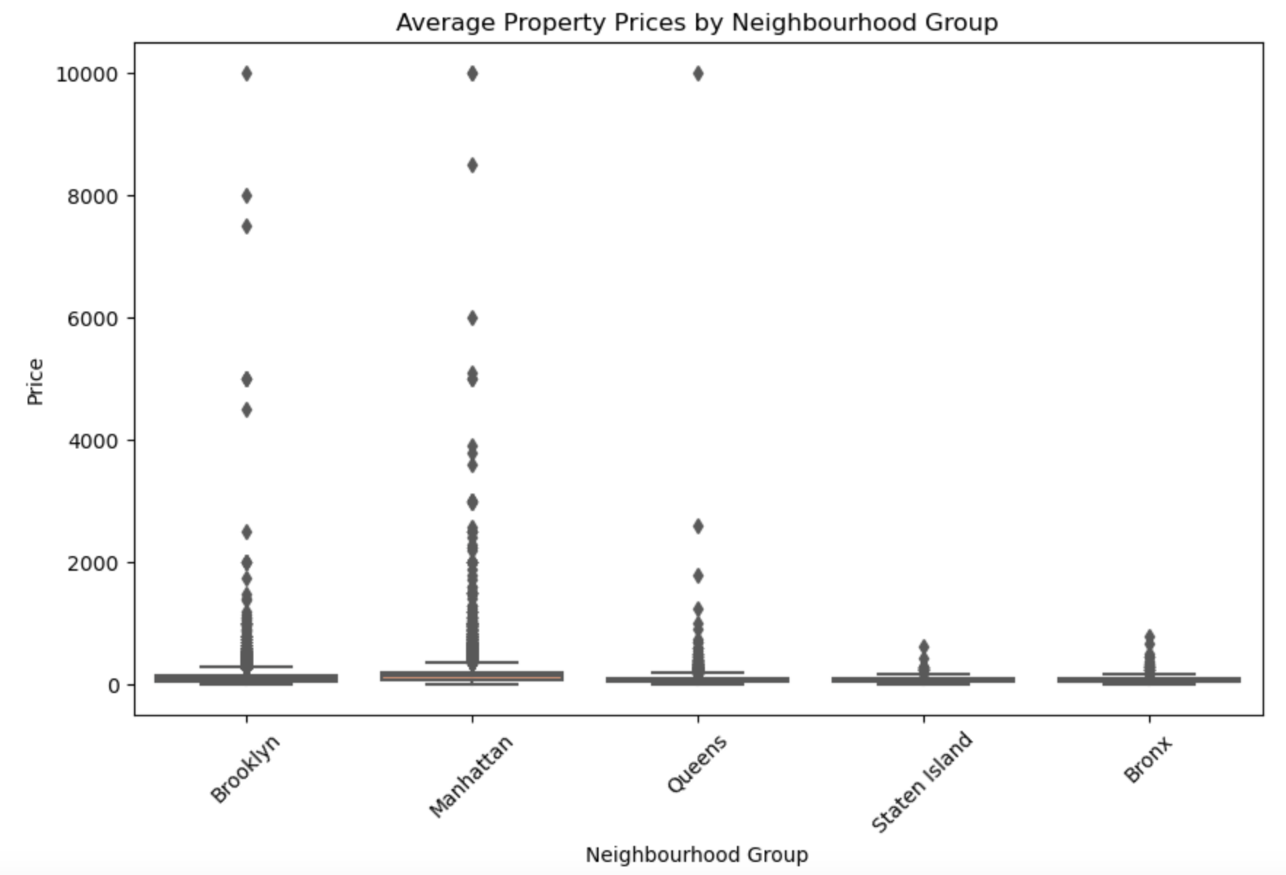
1. Comparison of Avg. Property Prices by Neighborhood Group

Slide 8
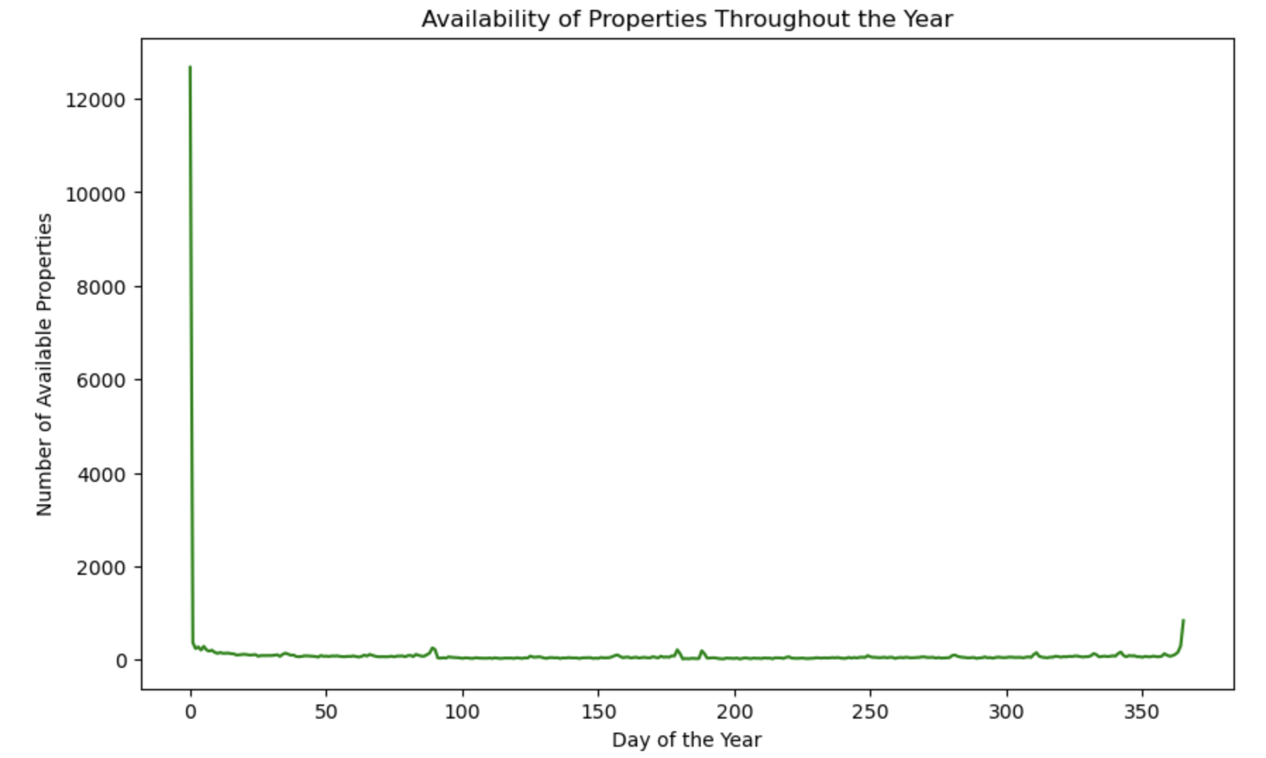
2. Visualization of the availability of properties throughout the year
Over here, it’s visible that most of the properties are available for shorter duration throughout the year

Slide 9
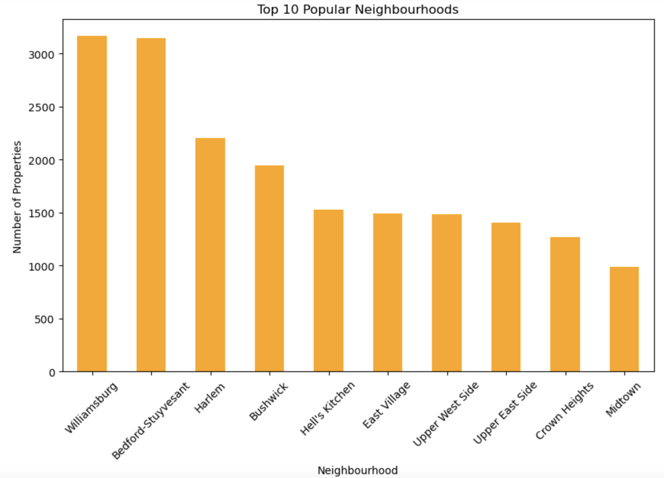
3. Comparison of the popularity of properties in different neighborhoods
Over here, ‘Williamsburg’ & ‘Bedford-Stuyvesant’ are the most popular neighbourhoods.

Slide 10
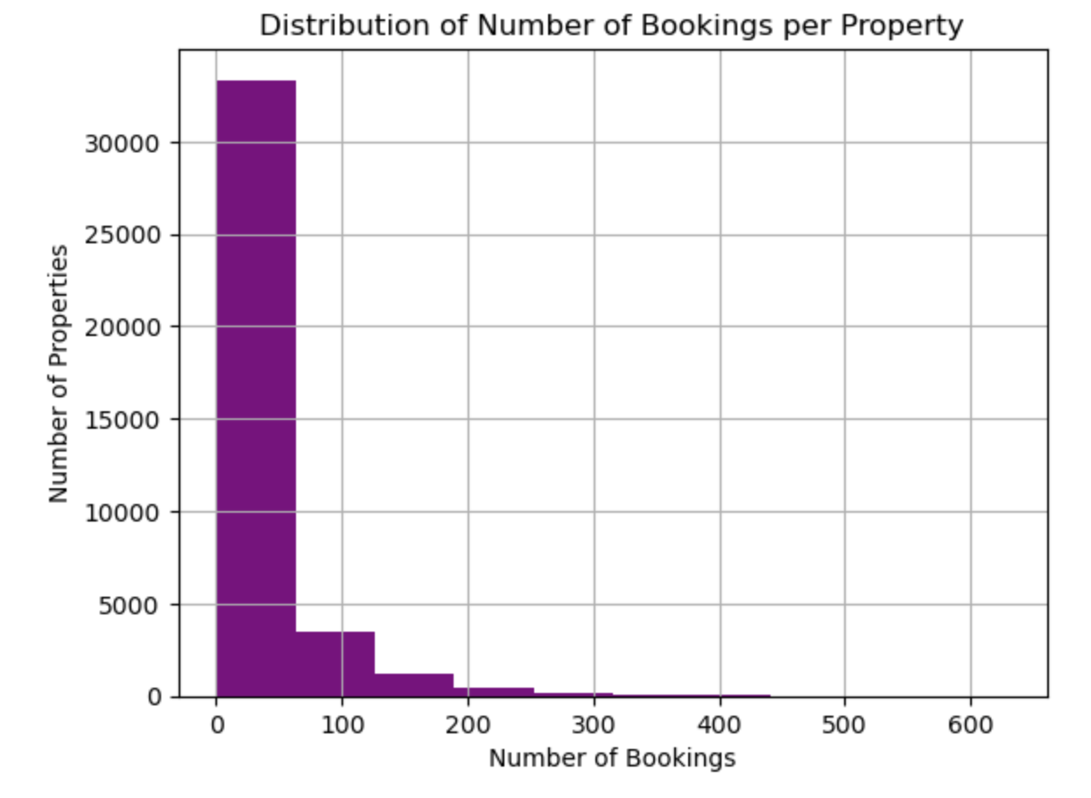
4. Distribution of Number of Bookings/Property
The graph shows that most number of properties are booked less than 100 times.

Slide 11
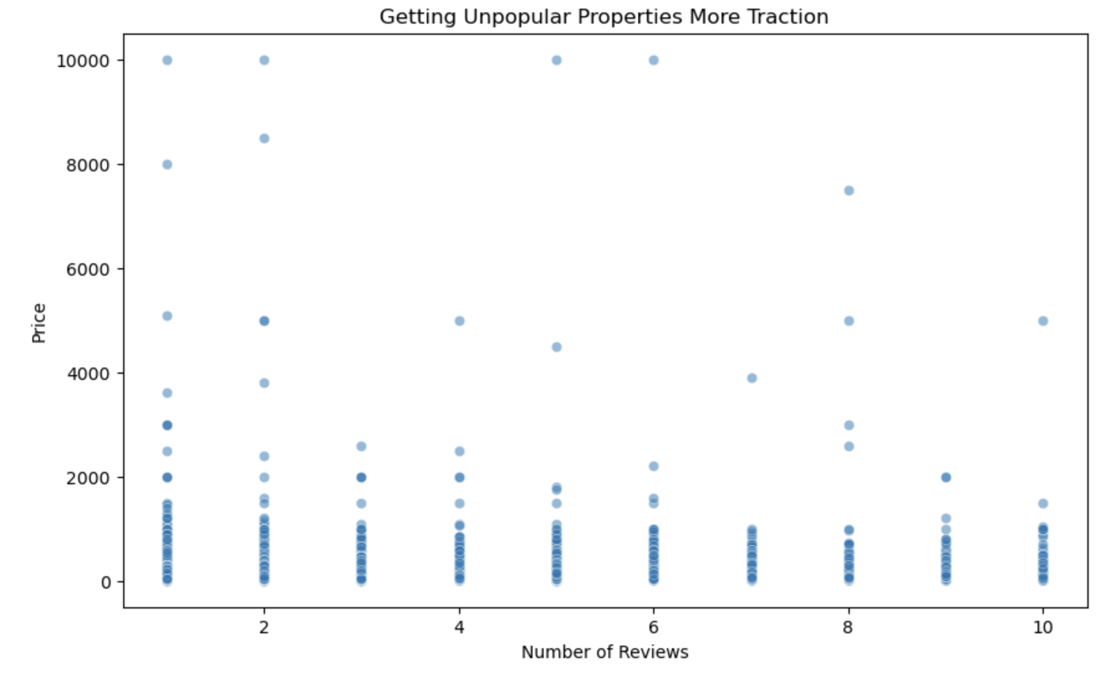
5. Visualization for getting unpopular properties more traction

Slide 12
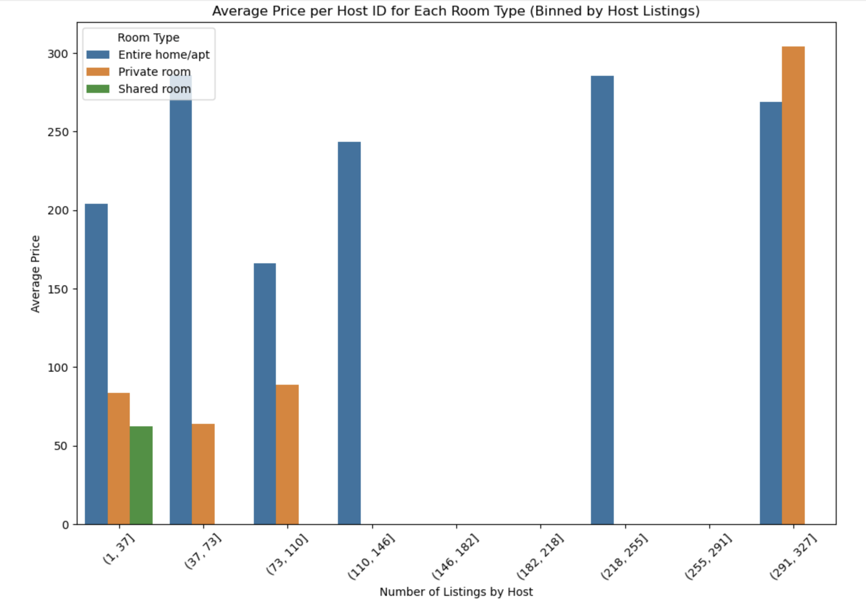
6. Average price per Host ID for each room type and binned host listings

Slide 13
Recommendations For Decision Making Using Analysis Done

Slide 14
Recommendations
Categorizing customers based on their preferences for room types and neighborhoods.
Targeting specific neighborhoods with potential for growth.
Adjusting pricing strategies based on customer preferences and seasonal trends.
Improving underperforming properties by making them more customer-oriented.
Identifying and promoting unpopular properties through targeted marketing strategies.
Exploring opportunities to expand in popular localities like Manhattan.
Utilizing machine learning models to predict prices and optimize revenue.

Slide 15
Methodology Document

Slide 16
Methodology Document - 1
1. Data Loading and Preprocessing:
- Data Loading:
- The Airbnb dataset containing property listings in New York City was loaded into a pandas DataFrame.
- Data Preprocessing:
- The 'last_review' column was converted to datetime format to facilitate temporal analysis.
- A new column named 'review_sentiment' was created by categorizing reviews into positive, neutral, and negative sentiments based on the reviews per month.
- Missing values were handled by dropping rows with null values.
2. Exploratory Data Analysis (EDA):
- Neighbourhood Price Analysis: The distribution of property prices across different neighbourhood groups was explored using boxplots. This provided insights into the variation in prices based on location.
- Property Availability Visualization:** The availability of properties throughout the year was visualized using a line plot. This analysis helped understand the seasonal trends in property availability.
- Top Neighbourhood Identification:** The top 10 popular neighbourhoods based on the number of listed properties were identified and visualized using a bar plot. This provided an overview of the most sought-after neighbourhoods.
- Number of Bookings Analysis:** The distribution of the number of bookings per property was examined and visualized using a histogram. This helped understand the popularity of properties based on the number of bookings.
- Unpopular Property Traction:** Strategies for increasing traction for unpopular properties were explored by creating a scatter plot of price vs the number of reviews. This analysis aimed to identify patterns that could help boost the popularity of less-reviewed properties.
- Price vs Reviews per Month:** The relationship between property price and reviews per month was investigated using a scatter plot. This analysis aimed to understand how price correlates with customer feedback.

Slide 17
Methodology Document - 2
3. Host and Room Type Analysis:
- Binned Host Listings Analysis: The host ids were binned based on the number of calculated host listings. The average price per host id for each room type within each bin was calculated and visualized using a bar plot. This analysis provided insights into the pricing patterns based on the number of listings per host, facilitating strategic decisions for property acquisition and pricing strategies.
This methodology document outlines the steps undertaken for data analysis, including data preprocessing, exploratory data analysis, and insights derived from visualizations to address the objectives of the analysis. Each step was accompanied by corresponding code snippets to demonstrate the implementation of the methodology.

